Slide 1
Stock Market Analysis
8 July 2024 to 12 July 2024

Slide 2
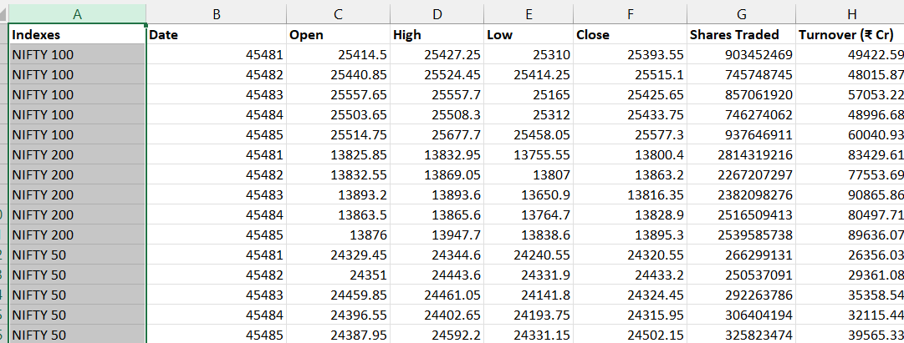
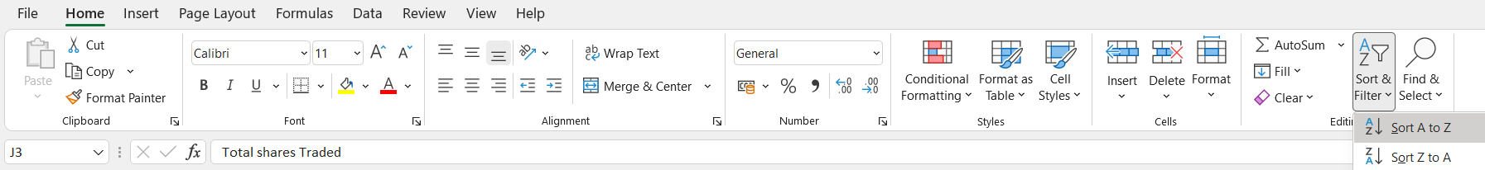
Sorting the data
Get the required data.
The headers should be in bold.
Select the Indexes column and sort the data in ascending order.
1
2
3

Slide 3
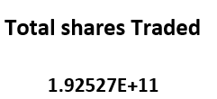
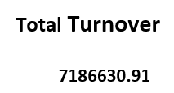
Sum formula
Next we find the total shares traded and total turnover.
Total shares traded
=SUM(Table1[[Shares Traded ]])
Total Turnover
=SUM(Table1[Turnover (₹ Cr)])

Slide 4
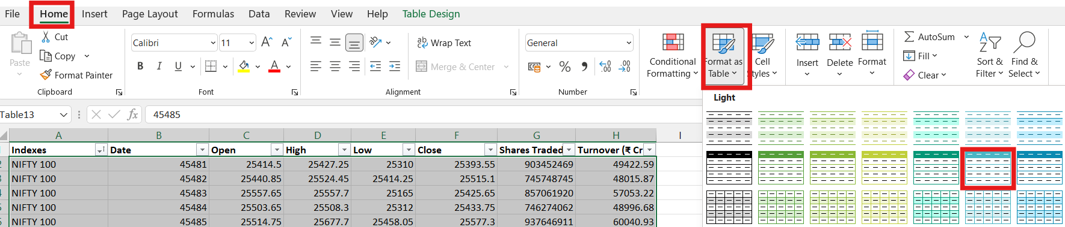
Table
Select the entire data and convert to the table.
Home → Format as Table → Select the table format.

Slide 5
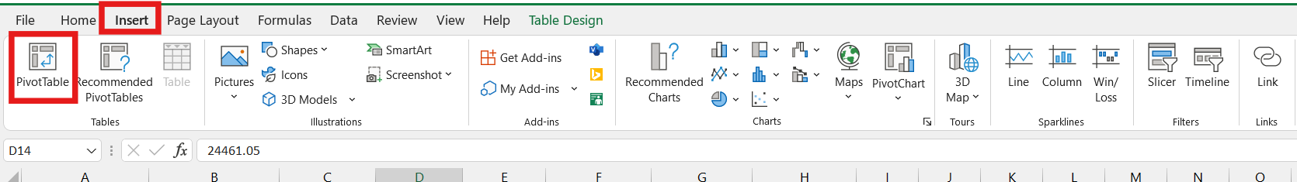
Create pivot table
Next, we create a pivot table.
Click on any one cell in the table.
Go to Insert → Click Pivot Table

Slide 6
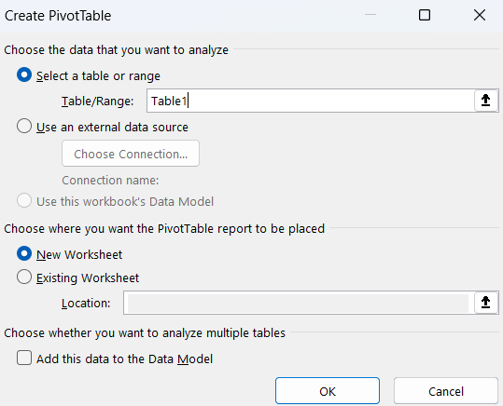
Dialogue box will open.
Click new worksheet to get the pivot table in new sheet.
Click ok.

Slide 7
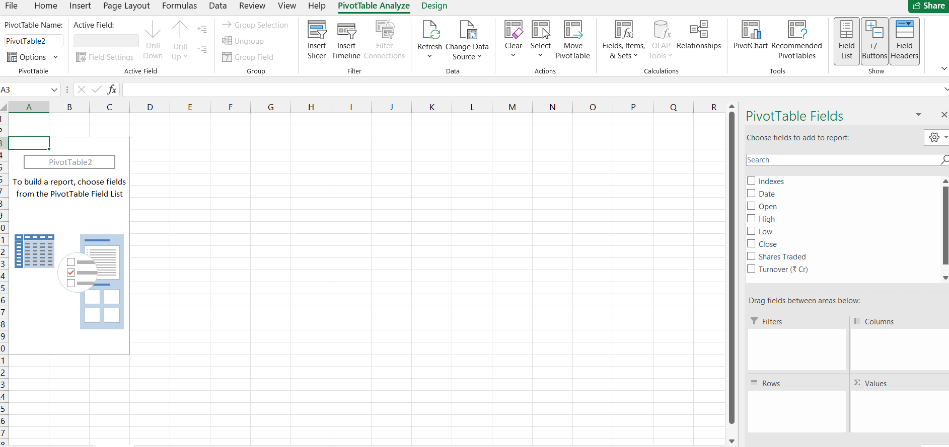
We get the pivot table.
Next, we create four pivot tables.

Slide 8
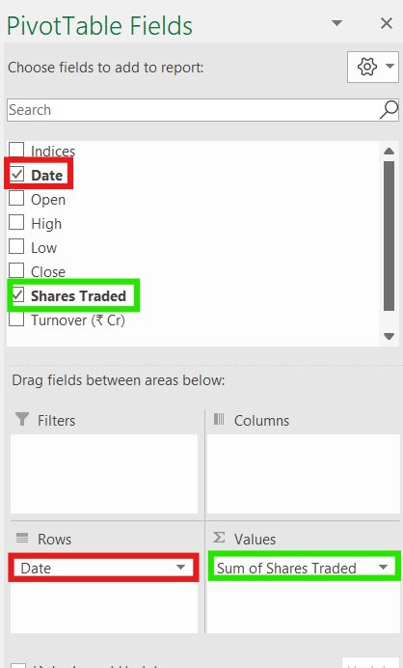
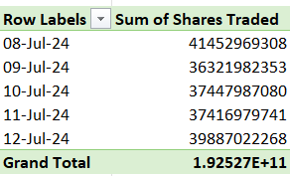
Click pivot table analyze → Field List
Then drag Date in rows and shares traded in Values area from the fields we get the pivot table.

Slide 9
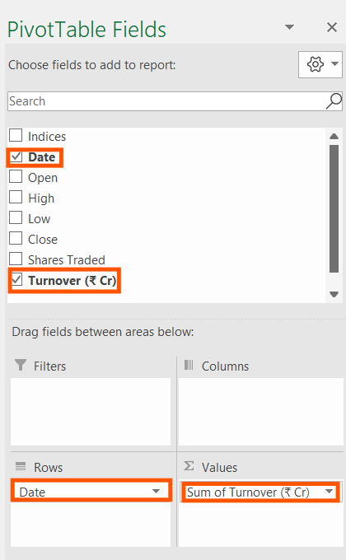
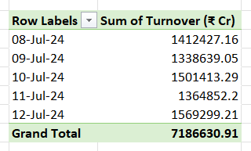
Drag Date in rows and Turnover in Values area from the fields we get the pivot table.

Slide 10
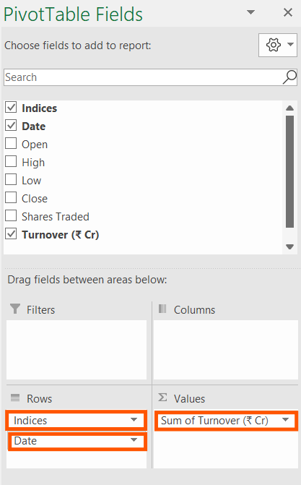
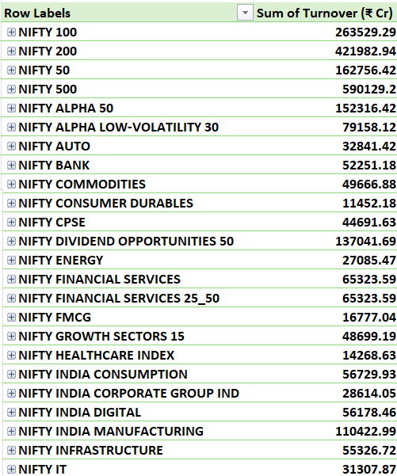
Drag indices and date in rows and turnover in values.

Slide 11
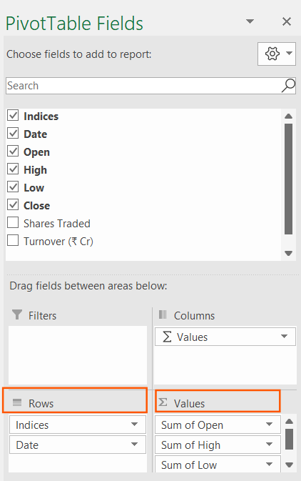
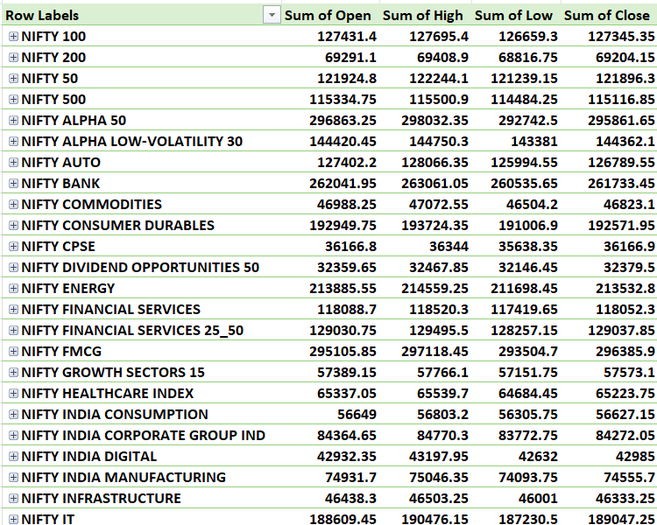
Drag indices and date in rows.
Drag open, high, low and close in values.

Slide 12
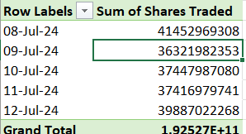
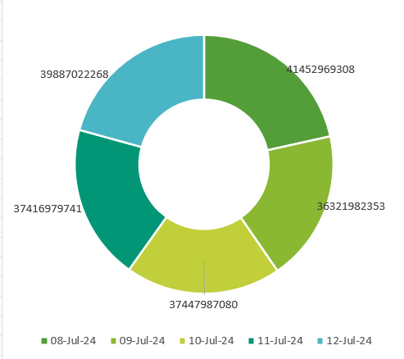
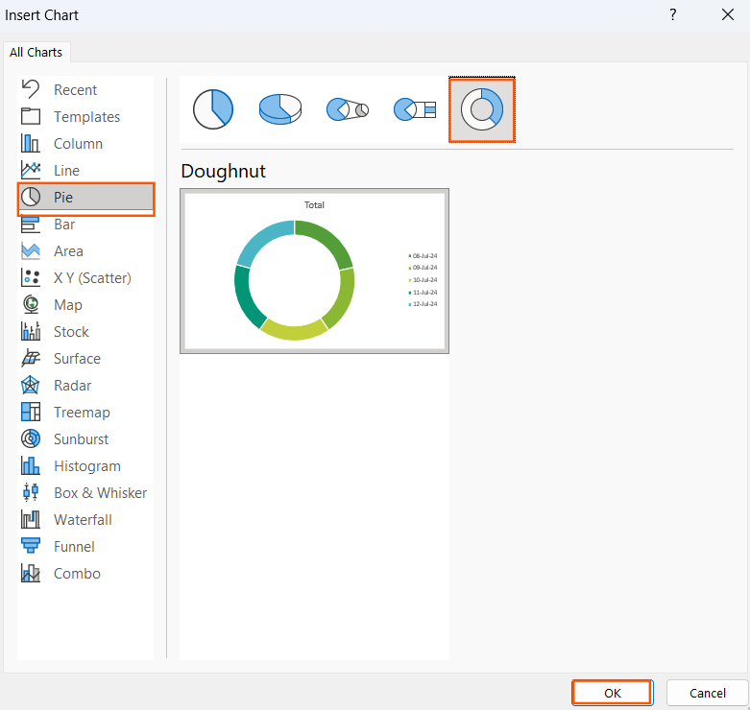
Pie chart
Next, we create charts for the pivot table.
Click on the pivot table → Pivot table analyze → Pivot chart → pie → Doughnut→ ok.

Slide 13
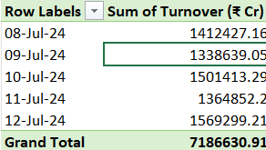
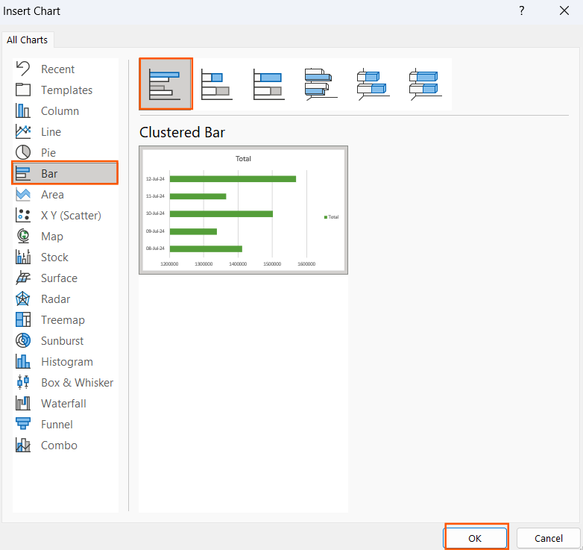
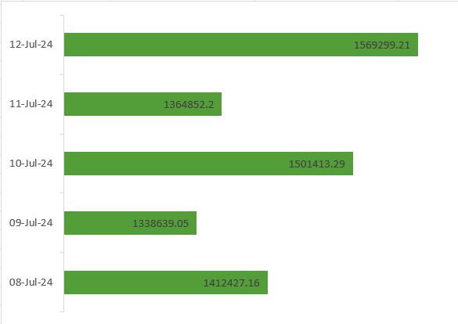
Bar chart
Click on the pivot table → Pivot table analyze → Pivot chart → bar → ok.

Slide 14
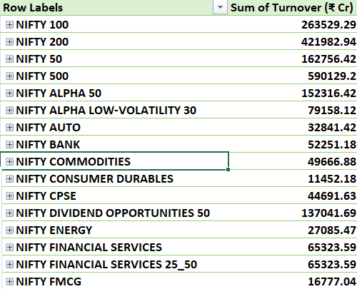
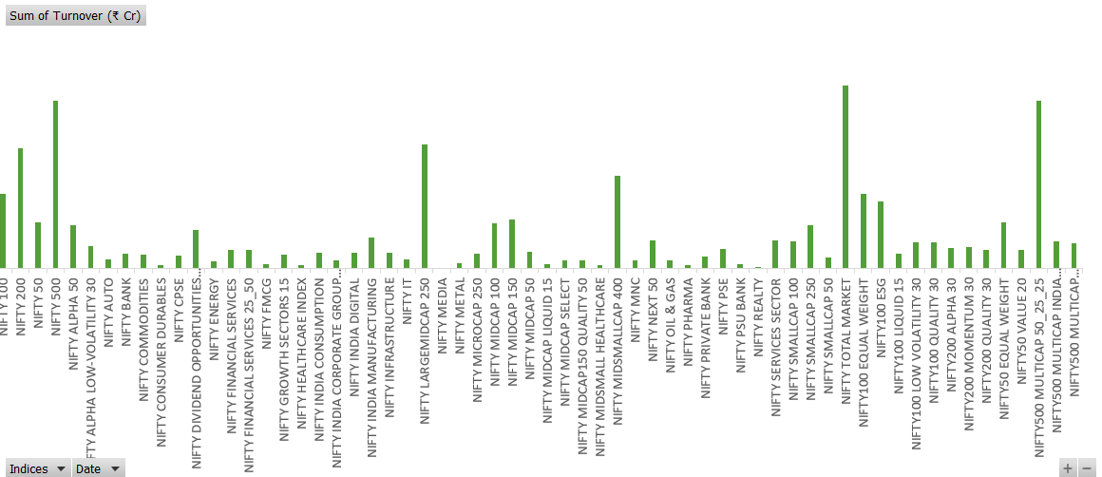
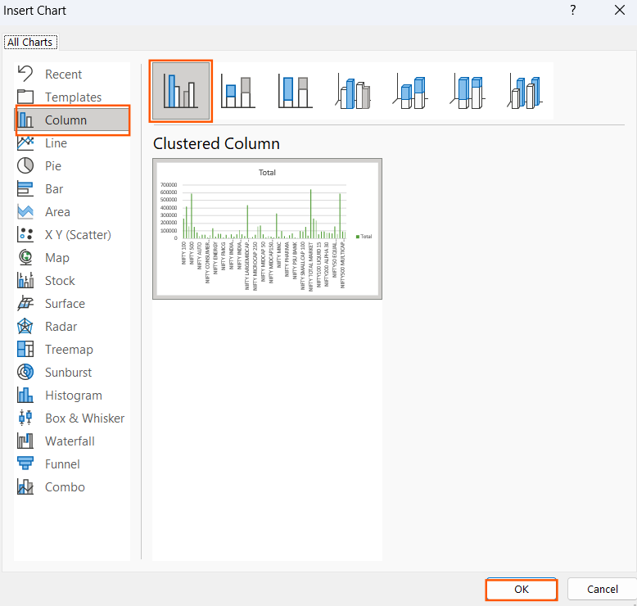
Column chart
Click on the pivot table → Pivot table analyze → Pivot chart → column → ok.

Slide 15
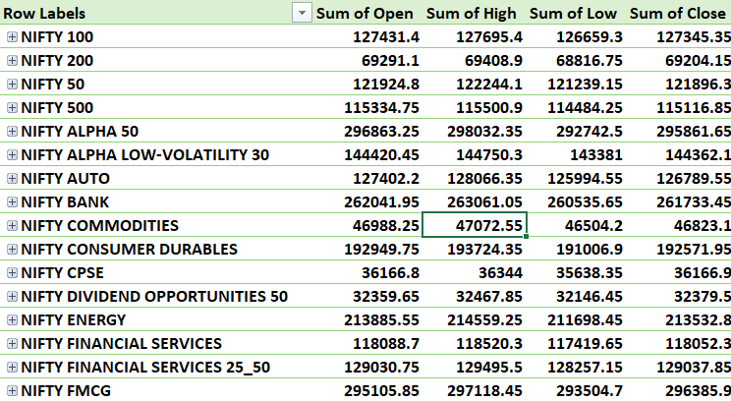
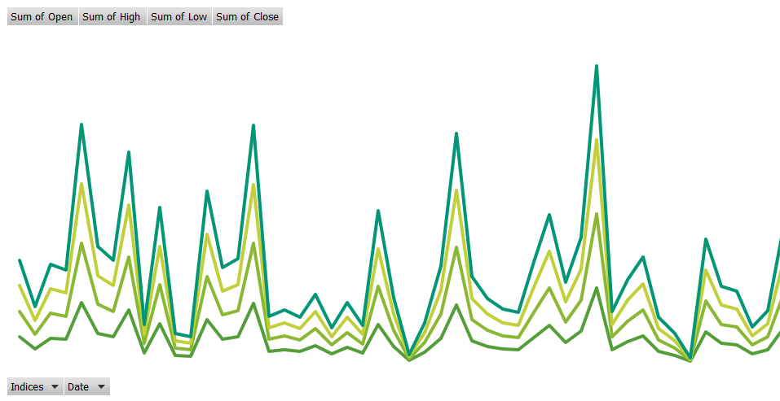
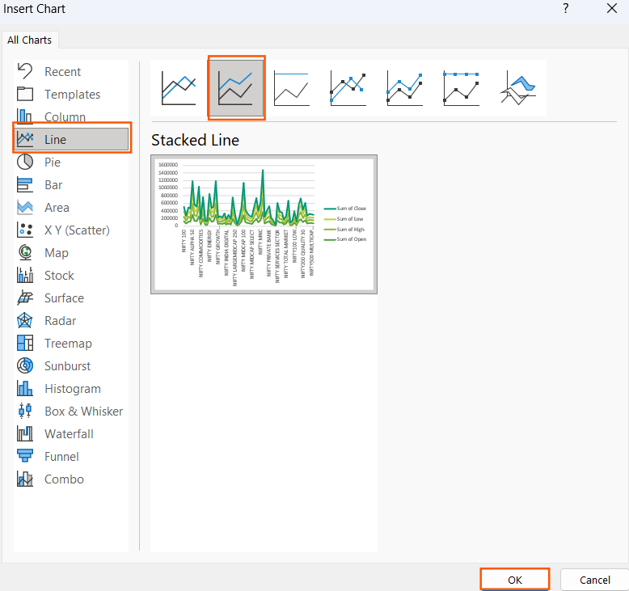
Line chart
Click on the pivot table → Pivot table analyze → Pivot chart → line → ok.

Slide 16
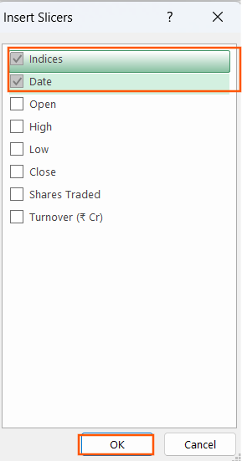
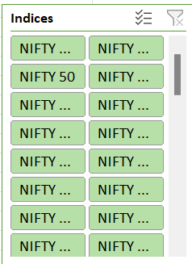
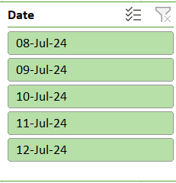
Create slicer
Next, we’ve to create a slicer.
Click on the pivot table → pivot table analyze → Insert slicer → click indices and date → ok.
We get the slicers of indices and date.

Slide 17
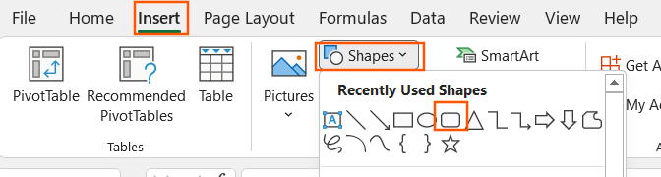
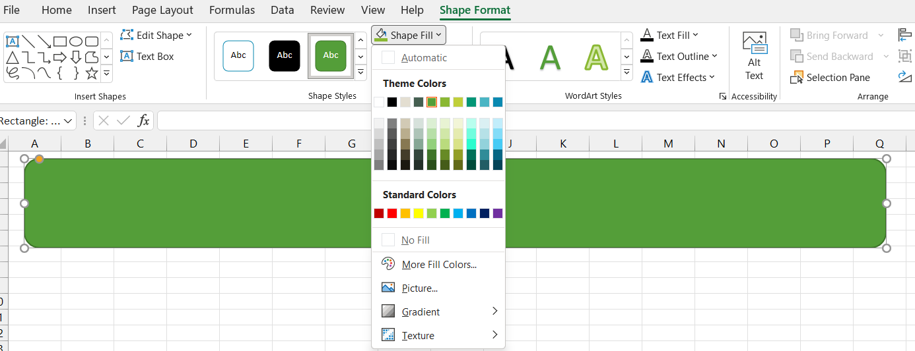
How to create a dashboard
Now, we create a dashboard.
Click insert → Shapes → select the rounded rectangle shape.
Drag the shape on the sheet and click shape format → set shape fill as white

Slide 18
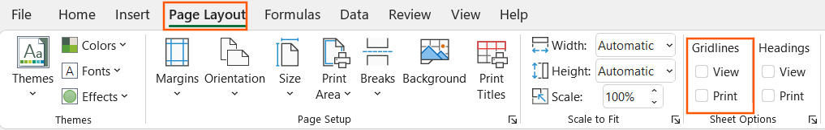
Next click shape outline → No outline.
Create a four shapes for the four charts.
Copy and paste the pivot charts.
Also copy and paste the slicer.
Select page layout → unselect view option in Gridlines.

Slide 19
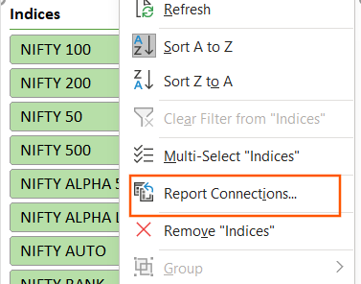
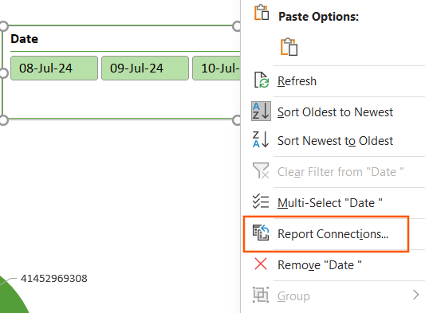
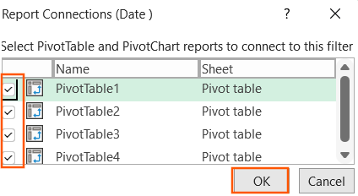
Report connections
Now, right click on the slicer → report connections → select all the pivot table → ok.

Slide 20
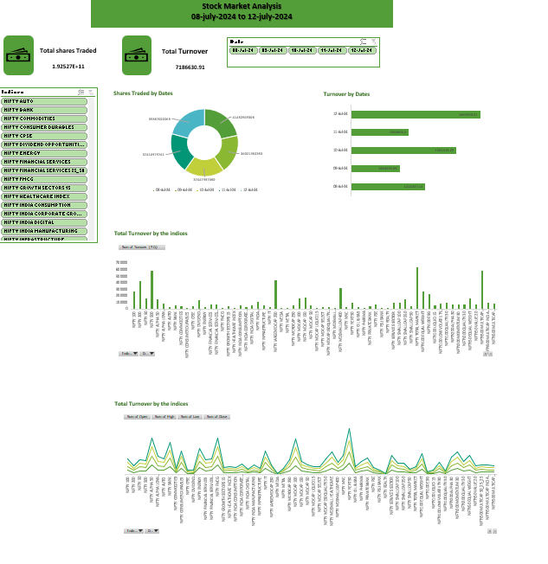
Dashboard

Slide 21
Thank you!

